Slide 1
More Linked Lists
Lecture 8A

Slide 2
LINKED LIST IMPLEMENTATION OF STRINGS

Slide 3
Strings
Array of char
char st1[15];
String starts in st1[0] and goes until an element containing a \0 is encountered.
  str[0]=‘\0’;
… will create an empty string
Can access individual characters, or the entire string (using library functions)

Slide 4
Character Codes
Each cell in an array of char holds a single number between 0 and 255
The number is interpreted as representing a specific character per the table of standard ASCII codes

Slide 5
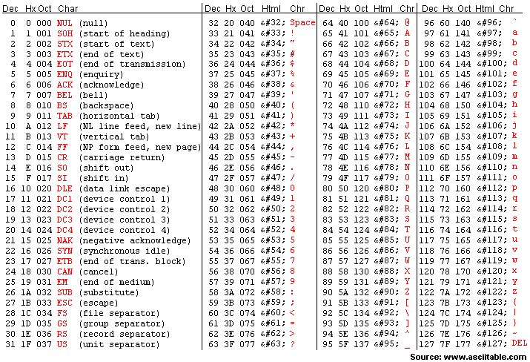
Standard ASCII Codes (0-127)

Slide 6
Dealing with Strings in C
Input/Output of strings <stdio.h>
  printf(“%s”, …
  scanf(“%s”, …
C has a library for strings <string.h>
  strcpy(dest,source);
    Copies one string to another, replacing original contents
  strlen(str)
    Returns the number of character in the string (up to 0)
  strcmp(str1,str2)
    Returns <0, 0 or >0 depending on whether str1 is <, == or > than str2
  strcat(dest,appsrc);
    Appends one string to the end of another

Slide 7
strcpy using an array of char
void myStrcpy(char dest[], char src[])
{
int i,srcLength;
srcLength = strlen(src)+1;
for(i=0;i<srcLength;i++)
{
dest[i]=src[i];
}
return;
}
void main(void)
{
char str1[80], str2[80];
scanf("%s",str1);
myStrcpy(str2,str1);
printf("%s\t%s\n",str1,str2);
}

Slide 8
strcpy using a pointer
char* myStrcpy(char *src)
{
return src;
}
void main(void)
{
char str1[80], *str3;
scanf("%s",str1);
str3 = myStrcpy(str1);
printf("%s\t%s\n",str1,str3);
}

Slide 9
A String as a Linked List
C
a
t
head
\0

Slide 10
A Node in a String …
typedef struct string {
char character;
struct string *next;
} string;

Slide 11
Converting a Result String to a Linked List Implementation
void main(void)
{
char origString[80];
string *aWord;
scanf("%s",origString);
aWord = malloc(sizeof(string));
aWord->character='\0';
aWord->next=NULL;
convert2string(aWord,origString);
dumpString(aWord);
}

Slide 12
convert2string
void convert2string(string *h, char original[])
{
int i=0; string *c,*l;
c = h;
while(original[i] != '\0')
{
l=c;
c = malloc(sizeof(string));
c->character = l->character;
c->next = l->next;
l->character = original[i];
l->next = c;
i = i + 1;
}
return;
}

Slide 13
dumpString
void dumpString(string *h)
{
while(h->character != '\0')
{
printf("%c",h->character);
h = h->next;
}
printf("\n");
}

Slide 14
You Could Convert Back Too
void convert2array(string *h, char original[])
{
int i=0;
while(h->character != '\0')
{
original[i]=h->character;
h=h->next;
i=i+1;
}
original[i]='\0';
return;
}

Slide 15
Alternate Implementation: main()
void main(void)
{
char origString[80],newString[80];
string *aWord;
scanf("%s",origString);
aWord=convert2string(origString);
dumpString(aWord);
convert2array(aWord,newString);
printf("%s\n",newString);
}

Slide 16
Alternate Implementation: convert2string()
string* convert2string(char original[])
{
int i=0; string *c,*l,*h;
h = malloc(sizeof(string));
h->character='\0';
h->next=NULL;
c = h;
while(original[i] != '\0')
{
l=c;
c = malloc(sizeof(string));
c->character = l->character;
c->next = l->next;
l->character = original[i];
l->next = c;
i = i + 1;
}
return h;
}

Slide 17
String Handling
All string manipulation in C is provided by libraries that use a contiguous array of characters to represent the string
Array implementation can be inefficient since it allocates the maximum amount of memory it will ever need every time you run it.
  War and Peace has 3,140,541 characters (including spaces)
  Alice in Wonderland has 141,058 characters (including spaces)

Slide 18
Things that are hard to do with an array implementation
It is difficult to do operations that increase or decrease the size of the string

Slide 19
Inserting Characters using an array
void main(void)
{
char aWord[25]={"this is 25 long"};
int i;
for(i=0;i<25;i++){printf("%c.",aWord[i]);}printf("\n");
for(i=23;i>7;i--)
{
aWord[i] = aWord[i-2];
}
for(i=0;i<25;i++){printf("%c.",aWord[i]);}printf("\n");
aWord[8] = 'a'; aWord[9] = ' ';
for(i=0;i<25;i++){printf("%c.",aWord[i]);}printf("\n");
}

Slide 20
Deleting Characters using an array
void main(void)
{
char aWord[25]={"this is 25 long"};
int i;
for(i=0;i<25;i++){printf("%c.",aWord[i]);}printf("\n");
for(i=8;i<25;i++)
{
aWord[i] = aWord[i+3];
}
for(i=0;i<25;i++){printf("%c.",aWord[i]);}printf("\n");
}

Slide 21
Easy to do with a linked list … deleting a character …
void deleteChar(string *h, int position)
{
int i; string *l;
if((position==1)||(h->next->next == NULL))
{
l=h->next;
h->character = h->next->character;
h->next=h->next->next;
}
else
{
for(i=1;i<position-1;i++)
{
h=h->next;
}
l=h->next;
h->next=h->next->next;
}
free(l);
return;
}

Slide 22
Deleting the character in position 9 (3 times)
void main(void)
{
char origString[25]={"this is 25 long"};
string *aWord;
aWord=convert2string(origString);
deleteChar(aWord,9);
deleteChar(aWord,9);
deleteChar(aWord,9);
dumpString(aWord);
}

Slide 23
So is adding a character …
void addChar(string *h, int position, char letter)
{
int i; string *c;
for(i=1;i<position-1;i++)
{
h=h->next;
}
c=malloc(sizeof(string));
c->character=letter;
c->next=h->next;
h->next=c;
return;
}

Slide 24
Adding 2 characters
void main(void)
{
char origString[25]={"this is 25 long"};
string *aWord;
aWord=convert2string(origString);
addChar(aWord,9,'a');
addChar(aWord,10,' ');
dumpString(aWord);
}

Slide 25
Do We Need to Use fscan for input?
No, we can build our own
void main(void)
{
char letter, aLine[120];
int lineLength=0;
letter = getc(stdin);
while(letter != '\n')
{
aLine[lineLength]=letter;
lineLength++;
letter = getc(stdin);
}
aLine[lineLength] ='\0';
printf("%s\n",aLine);
}

Slide 26
readString will load a linked list string from stdin
string* readString(void)
{
char letter;
string *c, *l, *h;
h = malloc(sizeof(string));
h->character='\0';
h->next=NULL;
letter = getc(stdin);
c=h;
while(letter != '\n')
{
c->character=letter;
l = c;
c = malloc(sizeof(string));
c->character='\0';
c->next = l->next;
l->next = c;
letter = getc(stdin);
}
return h;
}

Slide 27
Use putc()to display a linked list string
void dumpString(string *h)
{
while(h->character != '\0')
{
putc(h->character,stdout);
h = h->next;
}
printf("\n");
}

Slide 28
Reading/Writing a Line at a Time
void main(void)
{
string *aWord;
aWord=readString();
dumpString(aWord);
}

Slide 29
A Library of Linked List String Routines
string* readString(void)
string* convert2string(char[])
void convert2array(string*,char[])
void deleteChar(string*,int)
void addChar(string*,int,char)
void dumpString(string*)

Slide 30
Function prototypes
Functions should be declared before they are used
You can do this by
  putting them physically in the file before they are used
  use a function prototype – used especially if some functions are in a different file

Slide 31
An Example of function prototypes
string* readString(void);
string* convert2string(char[]);
void convert2array(string*,char[]);
void deleteChar(string*,int);
void addChar(string*,int,char);
void dumpString(string*);
These do not include the executable code or local variables – just the return type, name and type of each formal parameter
Usually in a .h file

Slide 32
Using .o Files
Three stages when we run gcc:
  Preprocessor
  Compile
  Link
We can stop short of linking and create object files (.o files):
    gcc –c stringLib.c
this creates an object file called stringLib.o
This can be linked to a C program later:
    gcc main.c stringLib.o

Slide 33
Program 8A
Using the string library we just went over, add to the library by providing a file containing a single function that removes a specific case insensitive letter from a string called deleteAll.c. For instance the string “The quick brown fox jumped over the lazy Dog” will look like: “The quick brown fox jumpe over the lazy og” if I use either deleteAll(aLine,’d’); or deleteAll(aLine,’D’);
I will provide my own main() to test it. It will look like this (except I may chose any letter to delete):
#include <stdio.h>
#include “stringLib.h” // contains the typedef for string
void main()
{
string *aLine;
aLine = readString();
dumpString(aLine);
deleteAll(aLine,’d’); // this is what you write
dumpString(aLine);
}

Slide 34
What You Will Need to Do
Create a .h file containing your typedefs and function prototypes (see the next page)
Reproduce the linked list string library we discussed today – compile into an object file
Create your function deleteAll() and put it in a file by itself
For testing purposes, you should create a main() similar to the one on the previous page in a file by itself

Slide 35
To Recap
Re-create the string library stringLib.c we saw today
Compile into a .o file:
gcc –c stringLib.c
Create your file deleteAll.c and a file main.c to test it
Compile and link it all:
gcc main.c deleteAll.c stringLib.o
Then test it to verify it works in various situations

Slide 36
stringLib.h
typedef struct string {
char character;
struct string *next;
} string;
//
// *** function prototypes
//
string* readString(void);
string* convert2string(char[]);
void convert2array(string*,char[]);
void deleteChar(string*,int);
void addChar(string*,int,char);
void dumpString(string*);

Slide 37
Program 8A Linked List
C
a
t
head
\0

